Slide 1


Embargoed for 5:30 p.m. ET 11-16-19
Global Study Comparing a rivAroxaban-based Antithrombotic Strategy to an antipLatelet-based Strategy After TAVR: Main Results of The GALILEO Trial
George Dangas, MD, PhD, Jan Tijssen, PhD, Gennaro Giustino, MD, Marco Valgimigli, MD, PhD, Pascal Vranckx, MD, Robert Welsh, MD, Karen Thomitzek, MD, Peter Wildgoose, PharmD, Ronald Van Amsterdam, PhD, Roxana Mehran, MD, and Stephan Windecker, MD
On The Behalf of The GALILEO Investigators

Slide 2
Disclosures
George Dangas, MD, PhD | Dr. Dangas reports grants from Bayer, during the conduct of the study; personal fees from Sanofi Aventis, personal fees from Bayer, personal fees from Janssen, grants and personal fees from Daiichi-Sankyo, other from Medtronic, outside the submitted work.
Jan Tijssen, PhD | Dr. Tijssen reports grants and personal fees from Bayer, during the conduct of the study.
Gennaro Giustino, MD | Dr. Giustino reports personal fees from Bristol-Myers-Squibb / Pfizer, outside the submitted work.
Marco Valgimigli, MD, PhD, | Dr. Valgimigli reports personal fees from Astra Zeneca, grants and personal fees from Terumo, personal fees from Alvimedica/CID, personal fees from Abbott Vascular, personal fees from Daiichi Sankyo, personal fees from Opsens , personal fees from Bayer, personal fees from CoreFLOW , personal fees from IDORSIA PHARMACEUTICALS LTD, personal fees from Universität Basel | Dept. Klinische Forschung, personal fees from Vifor, personal fees from Bristol Myers Squib SA, personal fees from iVascular , personal fees from Medscape, outside the submitted work.
Pascal Vranckx, MD | Dr. Vranckx reports personal fees from Bayer AG, during the conduct of the study; personal fees from Daichii Sankyo, personal fees from Astra Zeneca, personal fees from CLS Bhering, outside the submitted work.
Robert Welsh, MD, | Dr. Welsh reports grants and personal fees from Astra Zeneca, grants and personal fees from Bayer, grants and personal fees from Boerhinger Ingelheim, outside the submitted work.
Karen Thomitzek, MD | Dr. Thomitzek reports personal fees from Bayer, from null, outside the submitted work.
Peter Wildgoose, PharmD | Dr. Wildgoose reports and Employee of Janssen Pharmaceuticals, and stock holder in Johnson and Johnson.
Ronald Van Amsterdam, PhD | Dr. van Amsterdam has nothing to disclose.
Roxana Mehran, MD | Dr. Mehran reports grants from Bayer, during the conduct of the study; personal fees from Sanofi Aventis, personal fees from Bayer, personal fees from Janssen, grants and personal fees from Daiichi-Sankyo, other from Medtronic, outside the submitted work.
Stephan Windecker, MD | Dr. Windecker reports grants from Amgen , grants from Abbott, grants from Bayer, grants from BMS, grants from CSL Behring, grants from Boston Scientific, grants from Biotronik, grants from Medtronic, grants from Edwards Lifesciences, grants from Polares, grants from Sinomed, outside the submitted work.
ScientificSessions.org
#AHA19

Slide 3
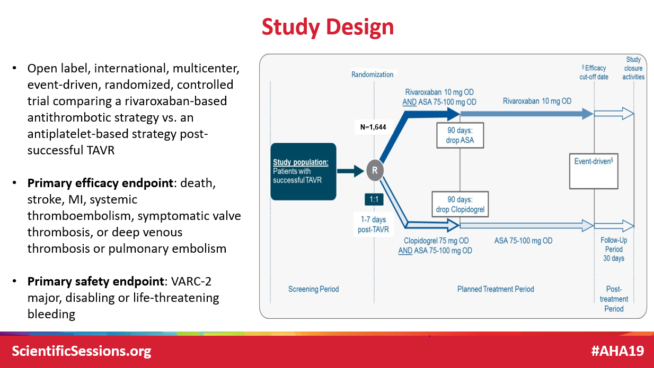
Background
Transcatheter Aortic Valve Replacement (TAVR) has been established as a standard of care for patients with severe symptomatic AS.
Thromboembolic complications have been observed early and late after TAVR
Subclinical leaflet thrombosis, observed with both TAVR and SAVR, has been associated with increased risk of cerebrovascular events in some observational studies
Current guidelines recommend the use of DAPT after TAVR, however these are based only on expert consensus and small studies
The oral Factor Xa inhibitor Rivaroxaban, at a 10 mg once daily dosage may be effective in reducing the risk of thromboembolic events post-TAVR
  N.B. this dosage lower than the 20mg (15mg for renal dfxn) daily indicated for stroke prevention in A.Fib
ScientificSessions.org
#AHA19

Slide 4
Key Inclusion and Exclusion Criteria
INCLUSION
EXCLUSION
Man or woman of 18 years of age or older
Have a successful transfemoral or trans-subclavian TAVR of an aortic valve stenosis (either native of valve-in-valve), defined as:
  Correct positioning of a single prosthetic heart valve into the proper anatomical location.
  Intended performance of the prosthetic heart valve - presence of all 3 conditions post-TAVR:
    Mean aortic valve gradient < 20 mmHg
    Peak transvalvular velocity (aortic valve maximum velocity) < 3.0 m/s
    No severe or moderate aortic valve regurgitation
  Absence of major periprocedural complications
With any approved/marketed TAVR device
Atrial fibrillation with an indication for OAC
Need for chronic oral anticoagulation
Any ongoing absolute indication for DAPT
Contraindication to aspirin, clopidogrel or rivaroxaban; known bleeding diathesis
Routine use of NSAIDs
Planned coronary or vascular intervention or major surgery
Clinically overt stroke within 3 months
Severe renal impairment (eGFR<30) or on dialysis, or post-TAVR unresolved acute kidney injury
Moderate and severe hepatic impairment or any hepatic disease associated with coagulopathy
Active infective endocarditis
Active malignancy
ScientificSessions.org
#AHA19

Slide 5
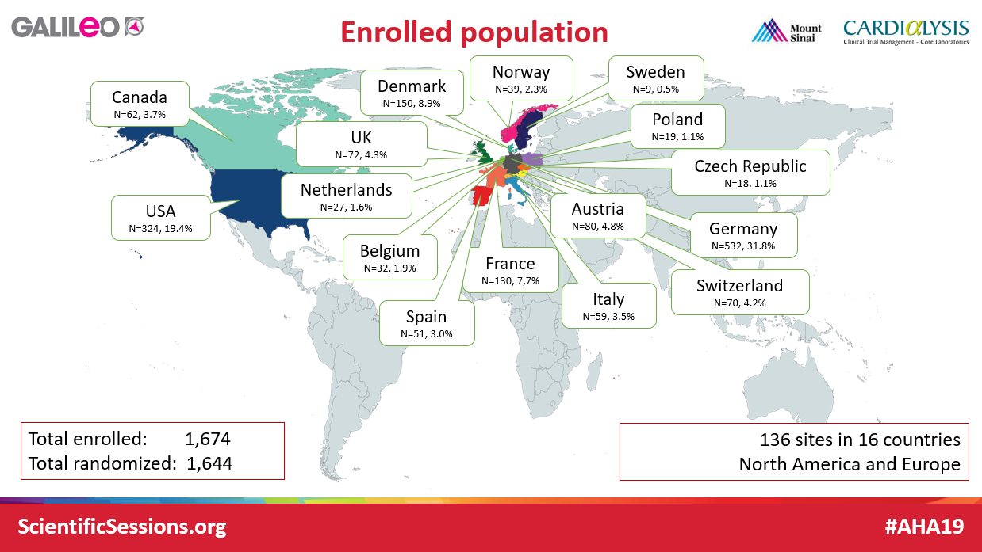
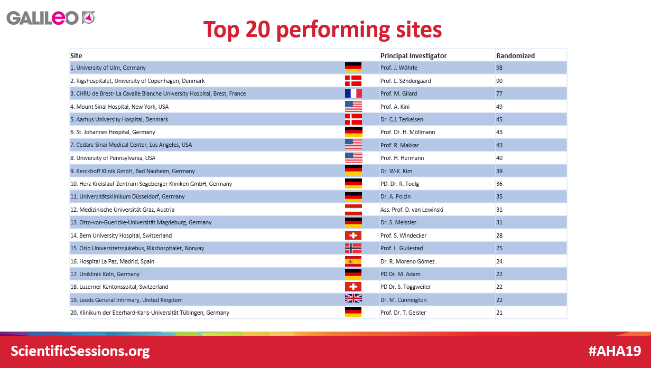


Study Organization
Executive Committee
G.D. Dangas (PI)
S. Windecker (PI)
R. Mehran
J.G.P. Tijssen
R.C. Welsh
P. Vranckx
M. Valgimigli
R.G.M. van Amsterdam
K. Thomitzek
P. Wildgoose
Steering Committee
Executive Committee members
A. Colombo
B. Prendergast
R. Makkar
M. Mack
J. Webb
Core Writing Committee
G. Giustino
A. Guimaraes
Event Adjudication Committee
S. O. Marx (Chair)
N. Corvaja
N. Ghodsi
D. DiStefano
D. Kaufman
J. Meller
M. Milstein
J. Weinberger
J. Y. Cha (administrator).
Data Safety Monitoring Board (DSMB)
K. Fox (Chair)
P. Block
S. Pocock
Statisticians Reporting to DSMB
T. de Vries
Study Statisticians & Programmers
B. Kirsch (Study statistician)
G. Verspohl (Study programmer, DATAN-Datenanalyse, Germany)
Clinical Coordinating Centers
Cardialysis, Rotterdam, the Netherlands Europe
Mount Sinai Medical Center, New York NY North America
Vigour Centre, Edmonton, Alberta Canada
National Leads
D. von Lewinski Austria
V. Legrand Belgium
R.C. Welsh Canada
P. Kala Czech Republic
L. Søndergaard Denmark
D. Tchétché France
H. Möllmann, S. Baldus, U. Schäfer German
C. Tamburino Italy
R. de Winter Netherlands
L. Gullestad Norway
P. Buszman Poland
R. Moreno Spain
S. James Sweden
S. Windecker Switzerland
D. Hildick-Smith United Kingdom
H. Herrmann, H. Dauerman United States of America
Sponsor: Bayer & Janssen
Funding: Bayer & Janssen
ScientificSessions.org
#AHA19

Slide 6
Statistical Methods
The primary hypothesis of the trial was that the rivaroxaban-based strategy would be superior to the antiplatelet-based strategy with respect to incidence of death or thromboembolic events.
  This testing was preceded by testing for non-inferiority in the on-treatment population.
Original assumptions included an 18-month incidence of the composite primary endpoint of 33.0% under the antiplatelet-based regimen and of 26.4% under the rivaroxaban-based regimen, corresponding to an HR of 0.7654. We estimated that 440 composite primary outcomes, occurring in 27,360 patient-months of follow-up, would provide the trial with 80% power to statistically detect the expected effect at a one-sided significance level of 0.025
The trial was terminated on August 13, 2018 (efficacy cut-off date) after the DSMB recommendation of 7 August 2018, due to safety concerns.
  Only 183 patients had reached the primary efficacy outcome (42% of planned 440)
ScientificSessions.org
#AHA19

Slide 7
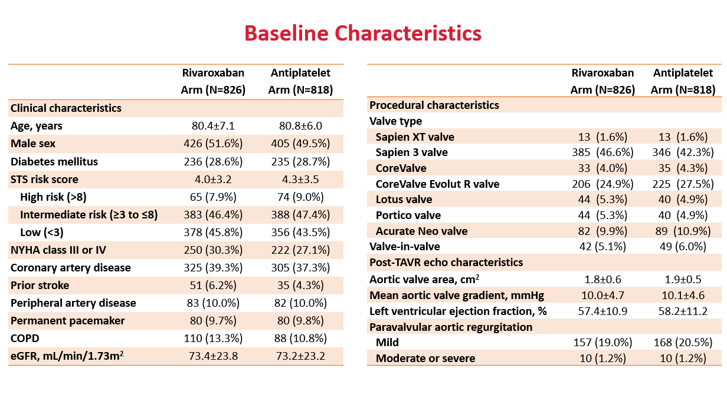
CONSORT Diagram
Subjects screened and consented
N=1,674
Consented but not randomized (N=30)
Adverse events (N=1)
Screen failure (N=17)
Subject withdrawal (N=6)
Other reasons (N=6)
Subjects randomized
N=1,644
Rivaroxaban arm
N=826
Treated: 801 (97.0%)
Untreated: 25 (3.0%)
Antiplatelet arm
N=818
Treated: 807 (98.7%)
Untreated: 11 (1.3%)
Did not complete study
N=27 (3.3%)
Adverse events (N=1; 0.1%)
Consent withdrawn (N=21;2.5%)
Lost to follow-up (N=5; 0.6%)
Did not complete study
N=26 (3.2%)
Adverse events (N=0)
Consent withdrawn (n=21;2.6%)
Lost to follow-up (N=5; 0.6%)
Complete Study
(N=799; 96.7%)
Complete Study
(N=792; 96.8%)

Slide 8
Primary Efficacy Endpoint (Intention-to-treat)
Time to death, stroke, myocardial infarction, symptomatic valve thrombosis, pulmonary embolism, deep vein thrombosis or systemic embolism
Rivaroxaban arm vs. Antiplatelet arm
Hazard ratio, 1.35 (95% CI: 1.01-1.81); p=0.04
0.20
105 events (9.8 per 100 person-years)
0.15
Rivaroxaban arm
78 events (7.2 per 100 person-years)
0.10
Cumulative risk
0.05
Antiplatelet arm
0.00
0
90
180
270
360
450
540
630
720
Number at risk
Days after randomization
Antiplatelet arm
818
779
740
699
622
496
339
211
93
Rivaroxaban arm
826
779
738
687
604
476
335
206
90
ScientificSessions.org
#AHA19

Slide 9
Primary Safety Endpoint (Intention-to-treat)
Time to VARC life-threatening, disabling or major bleeding
0.20
Rivaroxaban arm vs. Antiplatelet arm
Hazard ratio, 1.50 (95% CI: 0.95-2.37); p=0.08
0.15
Cumulative risk
0.10
Rivaroxaban arm
46 events (4.3 per 100 person-years)
0.05
31 events (2.8 per 100 person-years)
Antiplatelet arm
0.00
0
90
180
270
360
450
540
630
720
Days after randomization
Number at risk
Antiplatelet arm
818
784
748
712
634
503
338
211
92
Rivaroxaban arm
826
769
730
688
606
480
341
209
89
ScientificSessions.org
#AHA19

Slide 10
All-Cause Mortality (Intention-to-treat)
0.20
Rivaroxaban arm vs. Antiplatelet arm
Hazard ratio, 1.69 (95% CI: 1.13-2.53); p=0.009
0.15
Cumulative risk
64 events (5.8 per 100 person-years)
0.10
Rivaroxaban arm
38 events (3.4 per 100 person-years)
0.05
Antiplatelet arm
0.00
0
90
180
270
360
450
540
630
720
Days after randomization
Number at risk
Antiplatelet arm
818
797
765
728
650
519
351
218
95
Rivaroxaban arm
826
793
759
718
636
499
356
219
92
ScientificSessions.org
#AHA19

Slide 11
Efficacy & Safety Endpoints (Intention-to-treat)
Outcome | Rivaroxaban arm (N=826) |  | Antiplatelet arm (N=818) |  | Incidence Rate Difference (95% CI) | Hazard Ratio (95% CI)
 | n (%) | Incidence rate per 100 person-yrs | n (%) | Incidence rate per 100 person-yrs
Efficacy Outcomes
Primary efficacy outcome* | 105 (12.7%) | 9.8 | 78 (9.5%) | 7.2 | 2.6 (0.1; 5.1) | 1.35 (1.01-1.81)
Death | 64 (7.7%) | 5.8 | 38 (4.6%) | 3.4 | 2.4 ( 0.6; 4.1) | 1.69 (1.13-2.53)
Cardiovascular death | 35 (4.2%) | 3.2 | 27 (3.3%) | 2.4 | 0.7 (-0.7; 2.1) | 1.30 (0.79-2.14)
Non-cardiovascular death | 29 (3.5%) | 2.6 | 11 (1.3%) | 1.0 | 1.6 ( 0.5; 2.7) | 2.67 (1.33-5.35)
Stroke | 30 (3.6%) | 2.8 | 25 (3.1%) | 2.3 | 0.5 (-0.8; 1.8) | 1.20 (0.71-2.05)
Myocardial infarction | 23 (2.8%) | 2.1 | 17 (2.1%) | 1.5 | 0.6 (-0.6; 1.7) | 1.37 (0.73-2.56)
Symptomatic valve thrombosis | 3 (0.4%) | 0.3 | 7 (0.9%) | 0.6 | -0.4 (-0.9; 0.2) | 0.43 (0.11-1.66)
Pulmonary embolism | 3 (0.4%) | 0.3 | 2 (0.2%) | 0.2 | 0.1 (-0.3; 0.5) | 1.49 (0.25-8.93)
Deep vein thrombosis | 1 (0.1%) | 0.1 | 4 (0.5%) | 0.4 | -0.3 (-0.7; 0.1) | 0.25 (0.03-2.23)
Systemic embolism | 1 (0.1%) | 0.1 | 1 (0.1%) | 0.1 | 0.0 (-0.3; 0.3) | 0.98 (0.06-15.69)
Key secondary efficacy outcome† | 83 (10.0%) | 7.8 | 68 (8.3%) | 6.3 | 1.5 (-0.8; 3.7) | 1.22 (0.89-1.69)
Net Clinical Benefit║ | 137 (16.6%) | 13.2 | 100 (12.2%) | 9.4 | 3.8 ( 0.9; 6.7) | 1.39 (1.08-1.80)
Safety Outcomes
Primary safety outcome** | 46 (5.6%) | 4.3 | 31 (3.8%) | 2.8 | 1.5 (-0.1; 3.1) | 1.50 (0.95-2.37)
VARC life-threatening or disabling bleeding | 18 (2.2%) | 1.6 | 17 (2.1%) | 1.5 | 0.1 (-1.0; 1.2) | 1.06 (0.55-2.06)
Fatal bleeding | 2 (0.2%) | 0.2 | 1 (0.1%) | 0.1 | 0.1 (-0.2; 0.4) | 2.01 (0.18-22.19)
VARC Major bleeding | 30 (3.6%) | 2.8 | 15 (1.8%) | 1.4 | 1.4 ( 0.2; 2.6) | 2.02 (1.09-3.76)
TIMI major or minor bleeding | 42 (5.1%) | 3.9 | 24 (2.9%) | 2.2 | 1.7 ( 0.3; 3.2) | 1.78 (1.08-2.94)
ISTH major bleeding | 49 (5.9%) | 4.6 | 30 (3.7%) | 2.7 | 1.9 ( 0.2; 3.5) | 1.66 (1.05-2.62)
BARC type 2, 3 or 5 bleeding | 148 (17.9%) | 15.4 | 85 (10.4%) | 8.2 | 7.2 ( 4.2; 10.3) | 1.84 (1.41-2.41)
*Defined as the composite of death, stroke, myocardial infarction, symptomatic valve thrombosis, pulmonary embolism, deep vein thrombosis or systemic embolism; p-value=0.04 (2-sided p-value for difference calculated following the failed non-inferiority hypothesis test); †Defined as the composite of cardiovascular death, stroke, myocardial infarction, symptomatic valve thrombosis, pulmonary embolism, deep vein thrombosis or systemic embolism; ║Defined as the composite of Primary Efficacy of Primary Safety Outcomes; ** Defined as the composite of VARC life-threatening, disabling or major bleeding

Slide 12
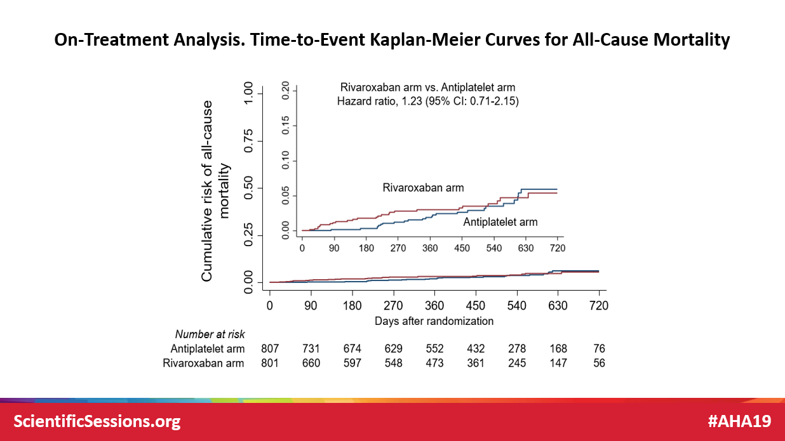
Efficacy & Safety Endpoints (On-Treatment Analysis)
Outcome | Rivaroxaban arm (N=826) |  | Antiplatelet arm (N=818) |  | Incidence Rate Difference (95% CI) | Hazard Ratio (95% CI)
 | n (%) | Incidence rate per 100 person-yrs | n (%) | Incidence rate per 100 person-yrs
Efficacy Outcomes
Primary efficacy outcome* | 68 (8.5%) | 8.1 | 63 (7.8%) | 6.6 | 1.5 (-1.0; 4.0) | 1.21 (0.86-1.70)
Death | 26 (3.2%) | 3.0 | 24 (3.0%) | 2.5 | 0.6 (-1.0; 2.1) | 1.23 (0.71-2.15)
Stroke | 24 (3.0%) | 2.8 | 19 (2.4%) | 2.0 | 0.9 (-0.6; 2.3) | 1.40 (0.77-2.55)
Myocardial infarction | 17 (2.1%) | 2.0 | 14 (1.7%) | 1.5 | 0.6 (-0.7; 1.8) | 1.37 (0.67-2.78)
Symptomatic valve thrombosis | 3 (0.4%) | 0.4 | 6 (0.7%) | 0.6 | -0.3 (-0.9; 0.4) | 0.58 (0.14-2.32)
Pulmonary embolism | 2 (0.2%) | 0.2 | 2 (0.2%) | 0.2 | 0.0 (-0.4; 0.5) | 1.06 (0.15-7.56)
Deep vein thrombosis | 0 | - | 4 (0.5%) | 0.4 | -0.4 (-0.8; -0.0) | -
Systemic embolism | 1 (0.1%) | 0.1 | 0 | - | 0.1 (-0.1; 0.4) | -
Key secondary efficacy outcome† | 61 (7.6%) | 7.3 | 56 (6.9%) | 5.9 | 1.4 (-1.0; 3.8) | 1.22 (0.85-1.75)
Net Clinical Benefit║ | 103 (12.9%) | 12.5 | 84 (10.4%) | 9.0 | 3.5 (0.4; 6.6) | 1.36 (1.02-1.81)
Safety Outcomes
Primary safety outcome** | 39 (4.9%) | 4.6 | 28 (3.5%) | 2.9 | 1.7 (-0.1; 3.5) | 1.53 (0.94-2.49)
VARC life-threatening or disabling bleeding | 14 (1.7%) | 1.7 | 16 (2.0%) | 1.7 | 0.0 (-1.2; 1.2) | 0.97 (0.47-1.98)
Fatal bleeding | 1 (0.1%) | 0.1 | 1 (0.1%) | 0.1 | 0.0 (-0.3; 0.3) | 1.06 (0.07-16.97)
VARC Major bleeding | 26 (3.2%) | 3.1 | 12 (1.5%) | 1.2 | 1.8 (0.5; 3.2) | 2.38 (1.20-4.71)
TIMI major or minor bleeding | 35 (4.4%) | 4.1 | 22 (2.7%) | 2.3 | 1.9 (0.2; 3.5) | 1.76 (1.03-3.00)
ISTH major bleeding | 42 (5.2%) | 5.0 | 27 (3.3%) | 2.8 | 2.2 (0.3; 4.0) | 1.71 (1.06-2.78)
BARC type 2, 3 or 5 bleeding | 137 (17.1%) | 17.1 | 74 (9.2%) | 8.1 | 9.1 (5.7; 12.5) | 2.04 (1.54-2.71)
*Defined as the composite of death, stroke, myocardial infarction, symptomatic valve thrombosis, pulmonary embolism, deep vein thrombosis or systemic embolism; †Defined as the composite of cardiovascular death, stroke, myocardial infarction, symptomatic valve thrombosis, pulmonary embolism, deep vein thrombosis or systemic embolism; ║Defined as the composite of Primary Efficacy of Primary Safety Outcomes; ** Defined as the composite of VARC life-threatening, disabling or major bleeding
Non-inferiority for the primary efficacy outcome not met given upper bound of 95% CI of HR of 1.70 (pre-specified of 1.20)

Slide 13
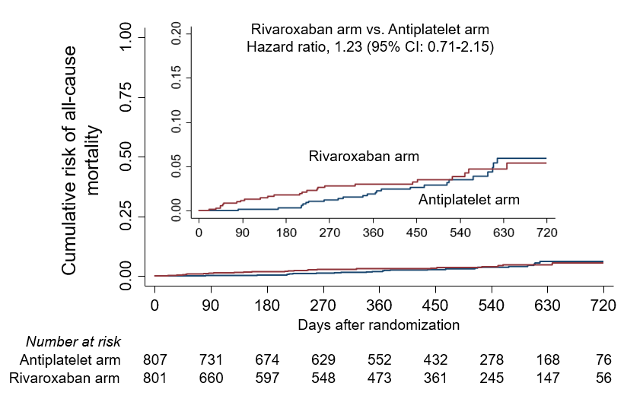
On-Treatment Analysis. Time-to-Event Kaplan-Meier Curves for All-Cause Mortality
ScientificSessions.org
#AHA19

Slide 14
Limitations
This trial employed open-label treatment and is potentially subject to reporting and ascertainment bias.
Prematurely terminated trial per DSMB recommendation; treatment effects and CIs need to be interpret with caution.
On-treatment analyses are subject to bias due to the high rates of treatment discontinuation
Patients undergoing TAVR with an established indication for anticoagulation were not included in this trial and treatment strategies for this patient population are being investigated in other clinical trials.
ScientificSessions.org
NEJM 2019; in press
#AHA19

Slide 15
Conclusions
In patients without an indication for oral anticoagulation after TAVR, a 10mg daily rivaroxaban-based antithrombotic strategy was associated with higher risk of death or thromboembolic events and bleeding compared to an antiplatelet-based antithrombotic strategy
The mechanism underlying the higher mortality in the rivaroxaban arm observed in the intention-to-treat analysis in this trial is unclear. The mortality rate differences were attenuated in the on-treatment analysis and occurred late after discontinuation of study drug.
These results of GALILEO main trial are irrespective of potential effects on valve imaging findings (GALILEO 4D-CT Ancillary Study)
ScientificSessions.org
NEJM 2019; in press
#AHA19

Slide 16
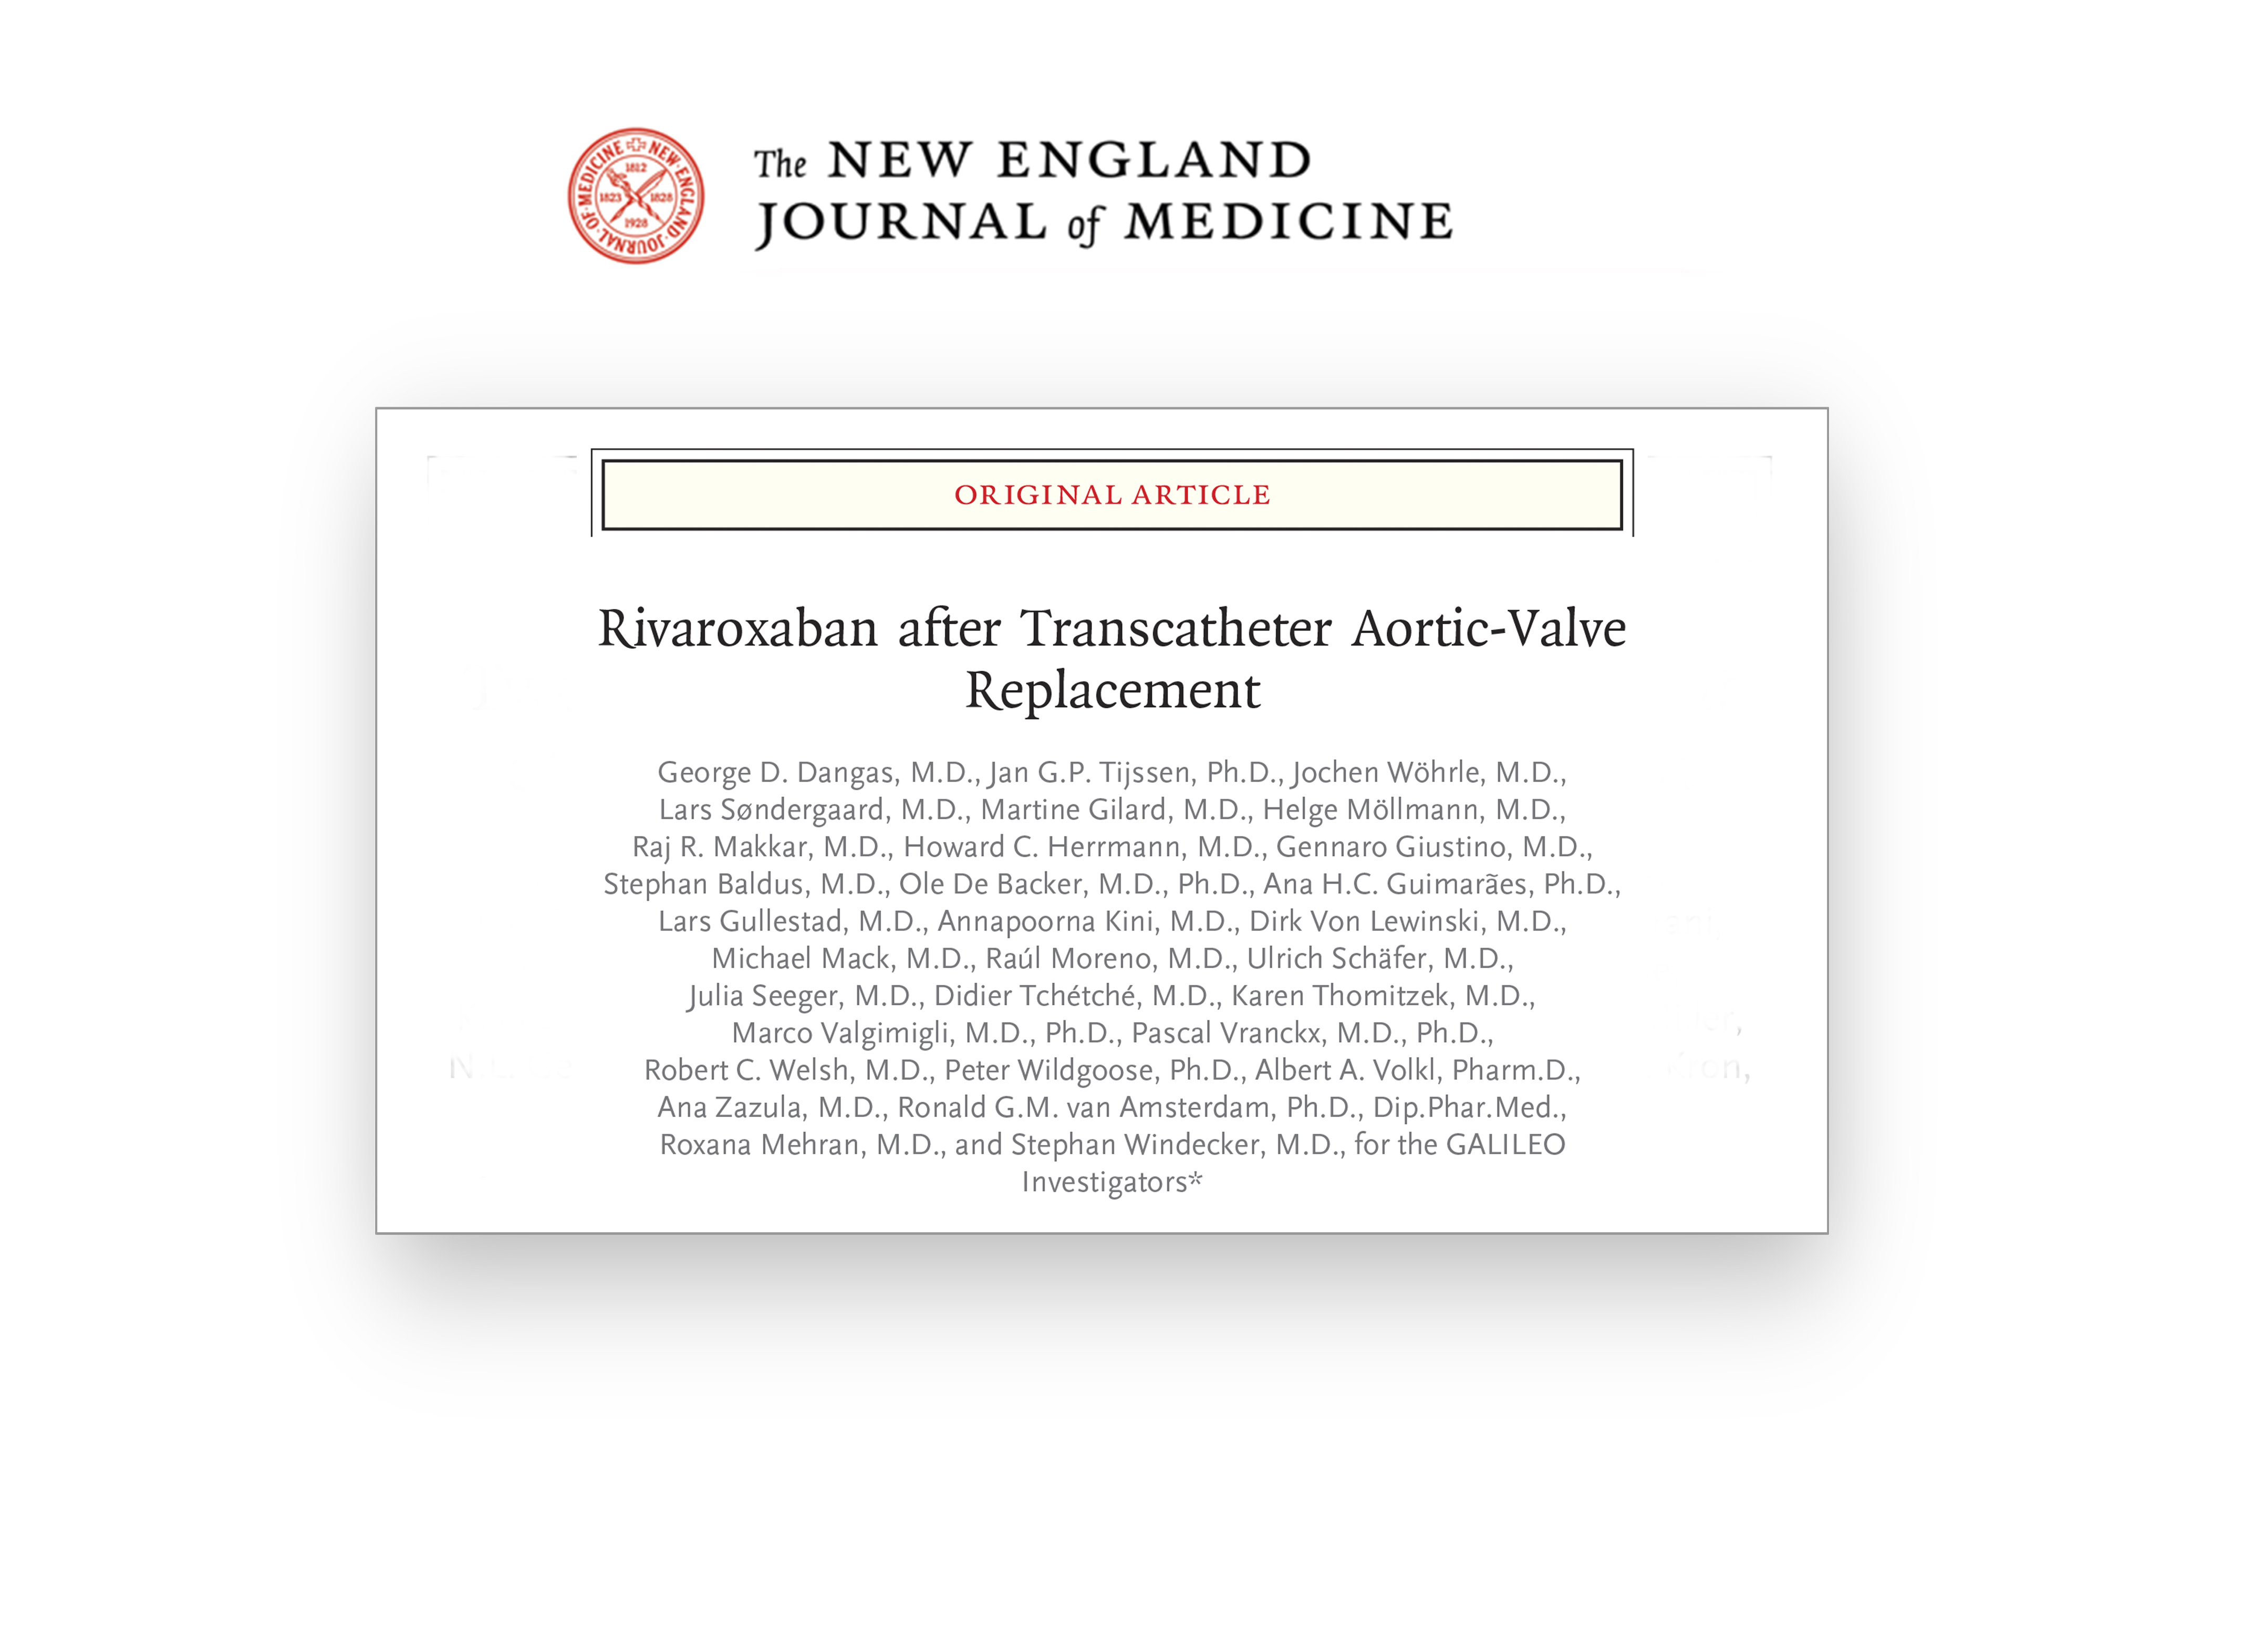

Slide 17

THANK YOU!

